Slide 1
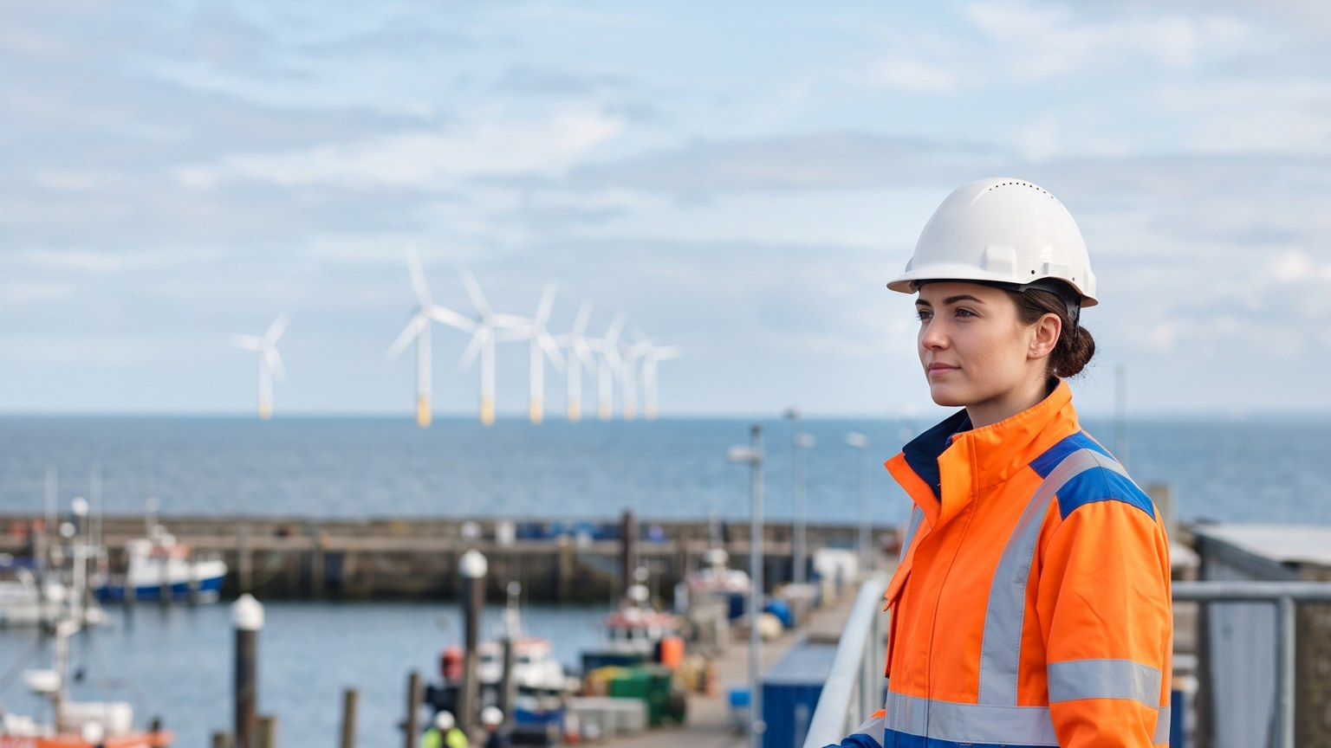
WEYLAND ENERGY
Powering the North – results
June–September 2026 · Leadership meeting, 6 October 2026

Slide 2
Headline results
5.2 m
1,145
4.6 %
17 %
impressions (target 4.5 m)
applications (target 1,000)
LinkedIn engagement (target 4.0 %)
share of voice (target 18 %)
WEYLAND ENERGY · Powering the North – results
2
Notes:
Share of voice just below target – the cable delay story in July pushed coverage of peers up too.

Slide 3
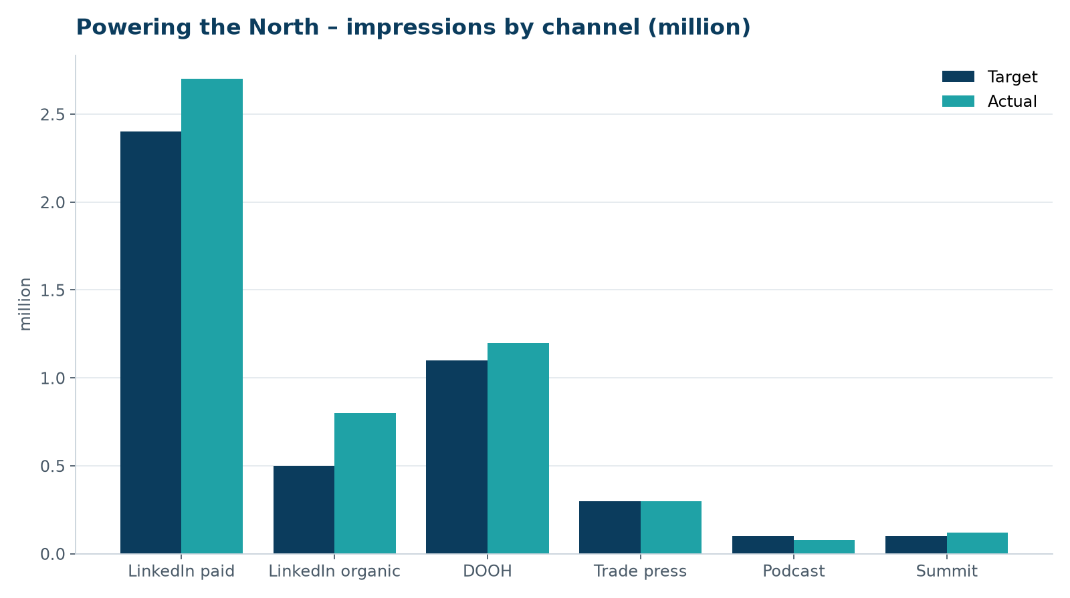
Reach by channel
• LinkedIn paid outperformed (+12 %)
• DOOH on plan
• Podcast under-delivered – downloads not verifiable
WEYLAND ENERGY · Powering the North – results
3

Slide 4
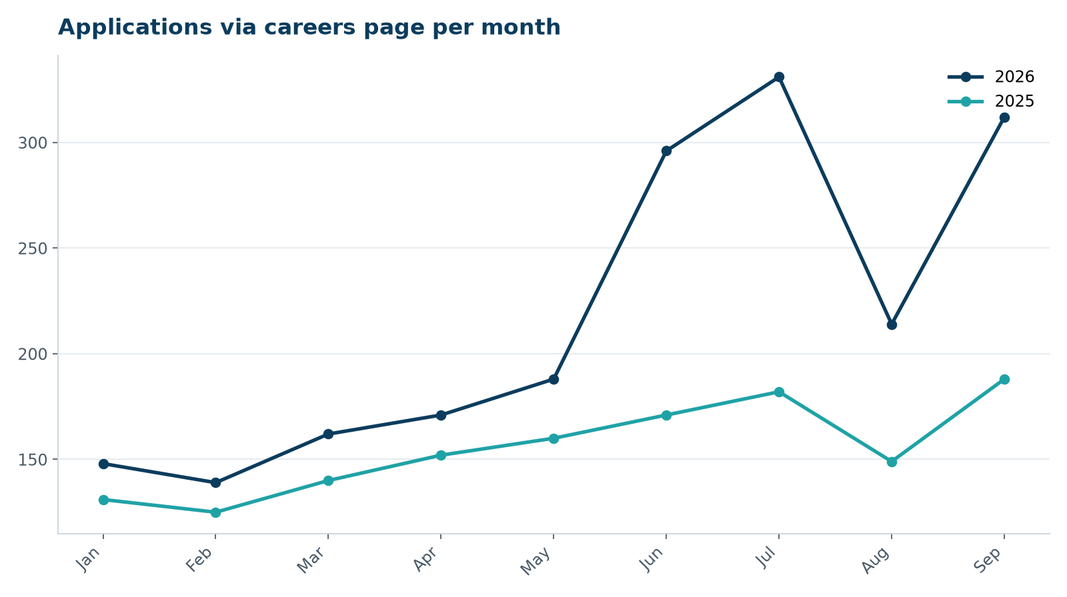
Applications
• +66 % vs. Jun–Sep 2025
• Peak in July after DOOH flight
• September boosted by summit
WEYLAND ENERGY · Powering the North – results
4

Slide 5
Awareness survey (September)
Region | Feb 2026 | Sep 2026 | Target
Hamburg | 9 % | 21 % | 20 %
Edinburgh | 6 % | 17 % | 20 %
Copenhagen | 4 % | 9 % | 20 %
WEYLAND ENERGY · Powering the North – results
5

Slide 6
Budget
• EUR 240,000 approved, EUR 230,600 committed
• EUR 9,400 contingency returned
• Cost per application EUR 201 (2025 job ads: EUR 340)
WEYLAND ENERGY · Powering the North – results
6

Slide 7
Recommendation
• Continue in 2027 with EUR 260k, add Copenhagen DOOH
• Drop podcast sponsorship
• New key visual once first turbines are installed (spring 2027)
WEYLAND ENERGY · Powering the North – results
7

Slide 8
WEYLAND ENERGY
Clean power, built to last.

